Slide 1
Traybot- Final Presentation
James Ravenhill-10699148
Ben Evans-10362555

Slide 2
Introduction and motivation
Covid 19 has affected everyone:
Businesses (Local/Global)
Retail
Work
Schools/Universities
It has had a huge impact on hospitals. Costing around £1bn per month.
https://www.hfma.org.uk/news/news-list/Article/nhs-covid-costs-are-more-than-1bn-a-month

Slide 3
Mission statement
"Traybot is to be used for logistical purposes including delivery of food or medical supplies to patients suffering from infectious diseases in order to reduce the risk to Doctors/nurses as well as freeing valuable time allowing the hospital staff to conduct more important tasks. The Traybot should be easy to sanitise as well as create a healthy Robot-Patient and Robot-Hospital relationship."

Slide 4
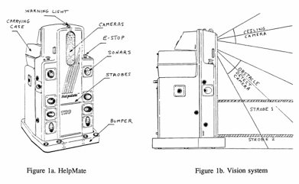
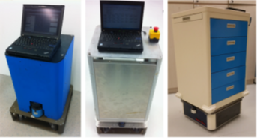
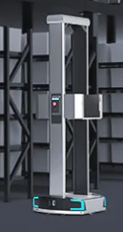
Research
Helpmate autonomous mobile robot (1991) [1]:
An early implementation (~1991)
Capable of transporting meal trays
Locates itself using ceiling camera- Does not require modification of the environment
Triple redundancy object avoidance- Bumper, Sonar, Structured light
Hospital mobile platform for logistics (2015)[2]:
Omni wheels were avoided due to noise and vibration concerns – This can be minimized, but this is still an area of research[3]
Regenerative braking identified as method to extend duty time
System requires manual loading/unloading
Geek+ mobile C Series picking robot [4]:
Capable of loading and unloading boxes from shelves.
Autonomous
Easy to maintain

Slide 5
Implementation
Autonomous navigation
traffic -busy hospital environment which copes for a highly dynamic environment.
NeoSLAM [5]
LIDAR sensors, cameras and motor encoders
Motion sensors in corridors of hospitals. Help determine traffic levels and path planning.
Teleoperation
Manual (in the event of an accident)

Slide 6
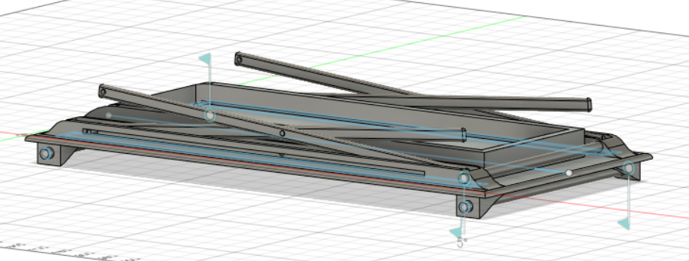
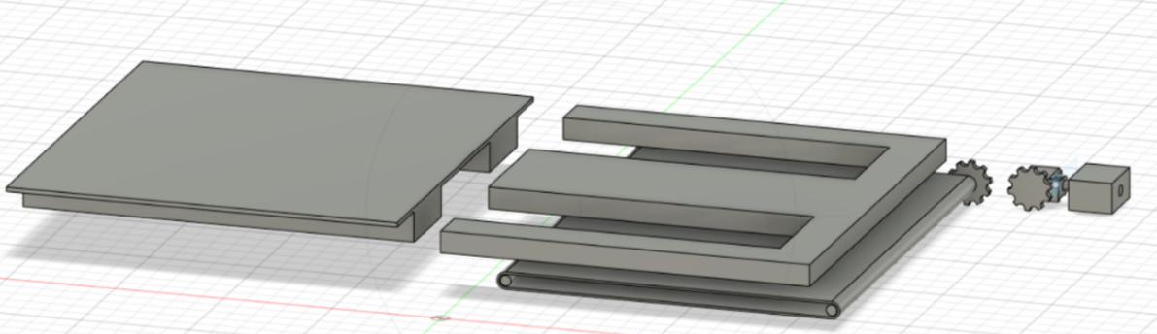
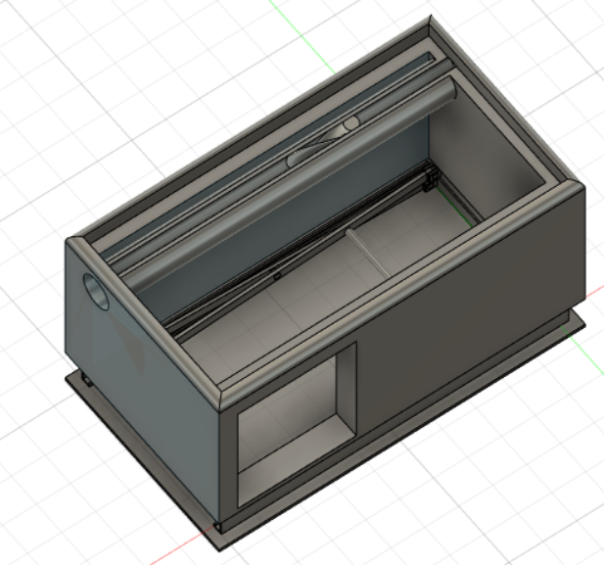
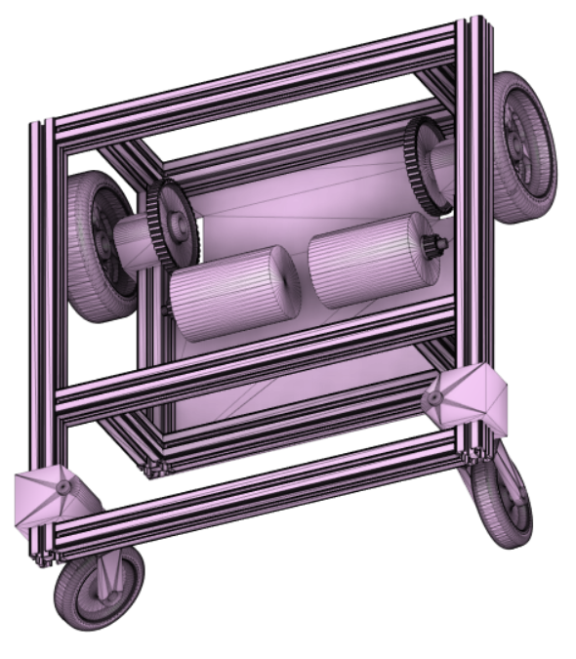
Design: initial concepts

Slide 7
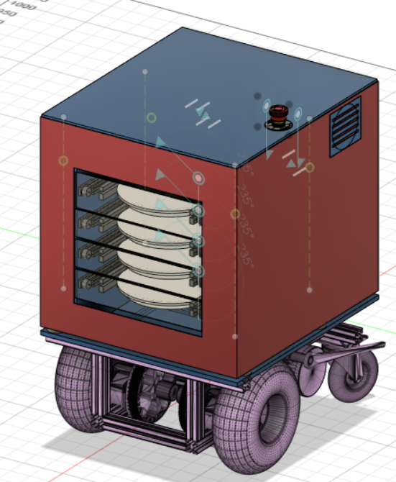
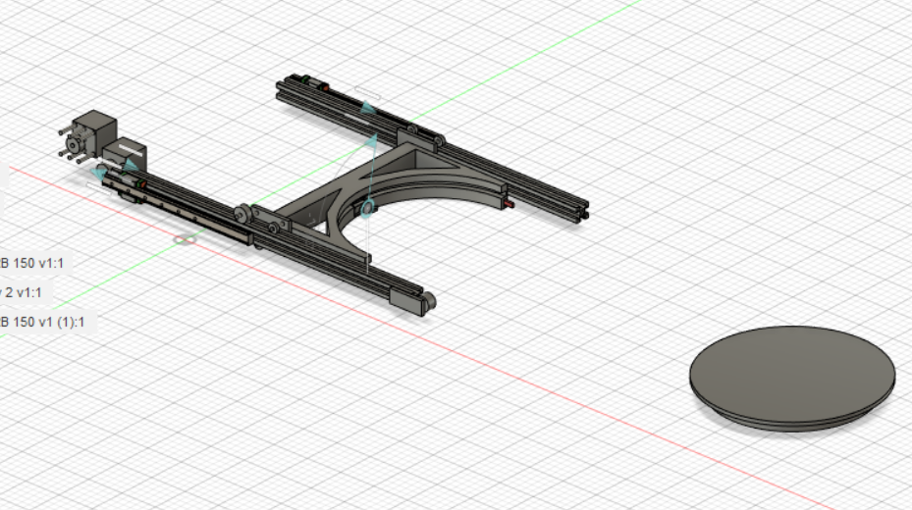
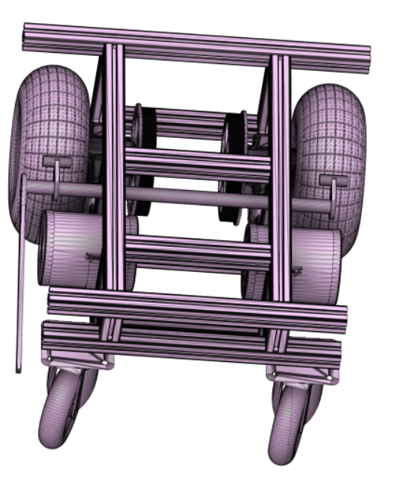
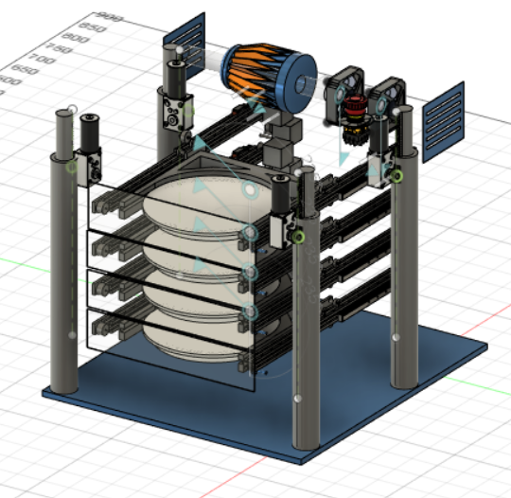
Design: final concepts

Slide 8
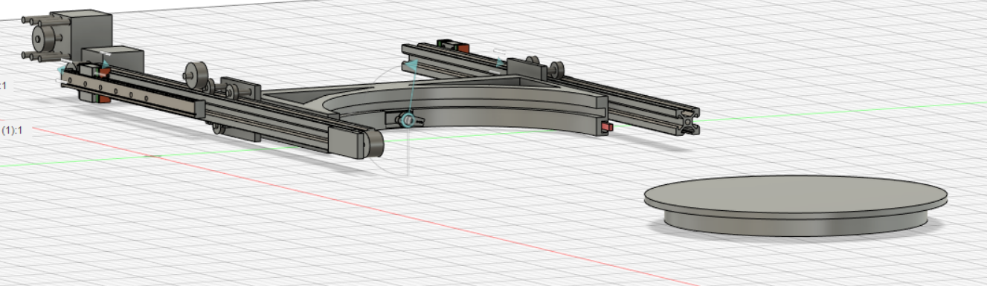
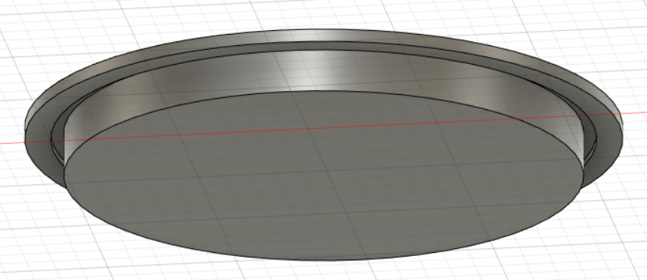
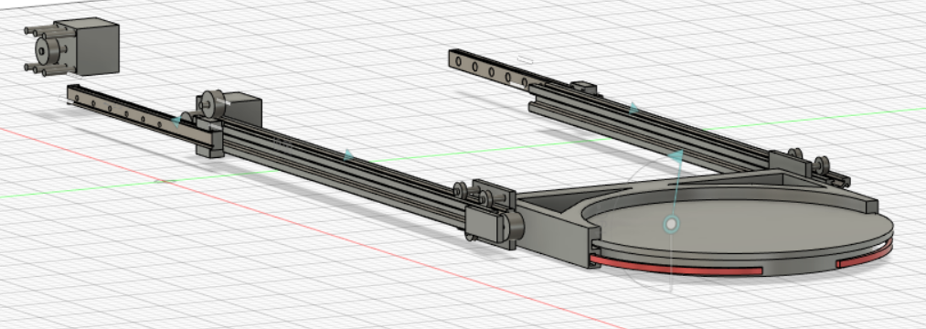
Tray mechanism in detail

Slide 9
Justification
Rack and pinion linear actuator-fulfils required torque, solves weight distribution issue.
Tray mechanism- telescopic design gives extended reach compared to previous rack and pinion and initial belt drive mechanism, Servo holds tray in place and worm gears extend the supports for the far side of the tray.
Robot main body- smaller than the initial design which gives higher agility for close quarters.
Air filter- simple, filter is easy to replace.
Wheelbase- adapted based on feedback received through PDR/CDR. Now includes breaking features. Differential drive with two caster wheels, similar to that of a wheelchair- can cope with hospital environment well.

Slide 10
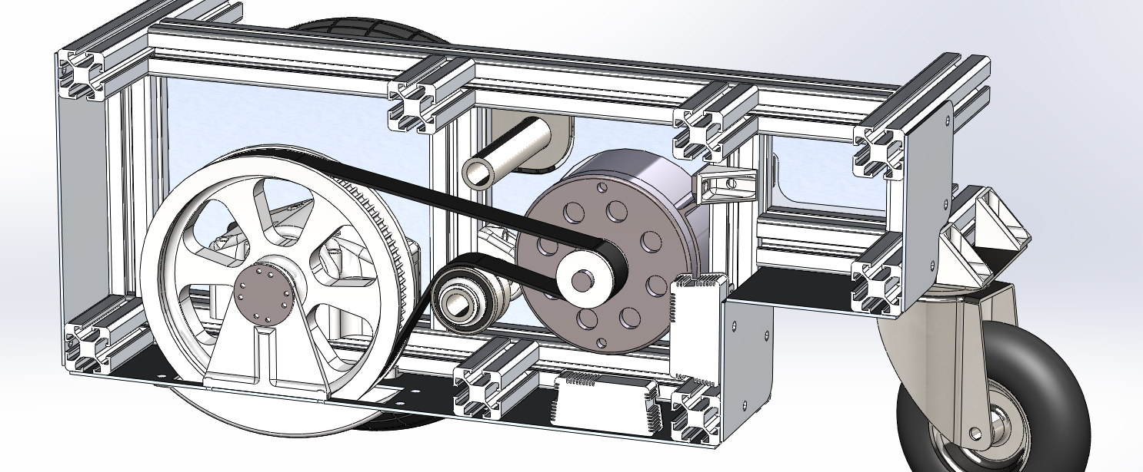
Mobile Base
Adjustable belt tensioner added

Slide 11
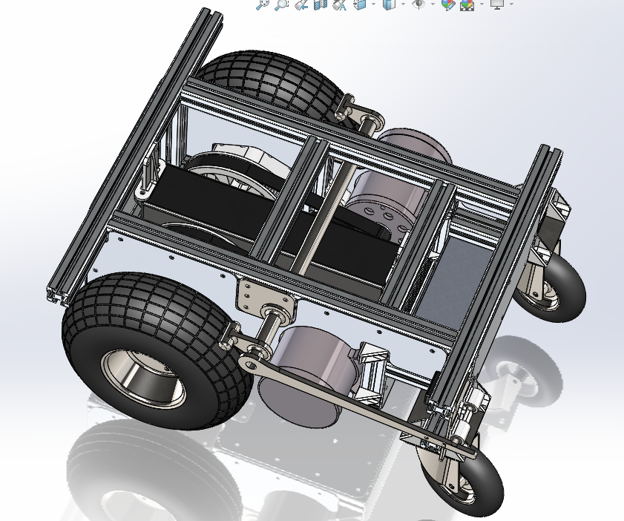
Final mobile base
Occupies 50x55cm footprint
Inbuilt failsafe brake
Houses single 280Wh li-ion battery
Rear compartment left empty for control and communication electronics

Slide 12
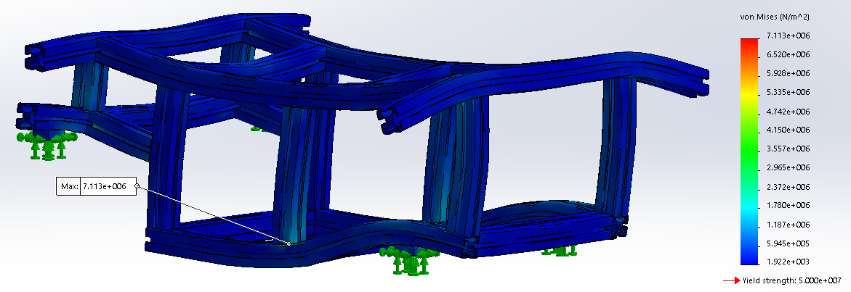
FEA of frame loadbearing
Stress induced by 80kg load of main body gives a minimum safety factor of 7.03.
Does not account for extrusion connectors as a weak point

Slide 13
Proof of concept
The simulated Traybot can be seen performing a pick and place task under teleoperated control at:
www.youtube.com/watch?v=DZTewCjgizs

Slide 14
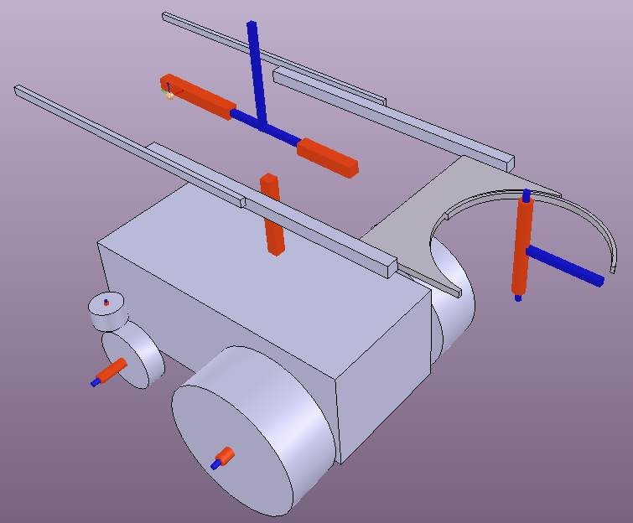
Dynamic model used in simulation, showing kinematics of all Traybot joints.

Slide 15
Costs and materials
Main body: £1,186.93
Mobile base: £527.48
Sensors and control: £123.22
Overall total: £1,837.6
Cost estimation: £2,756.45

Slide 16
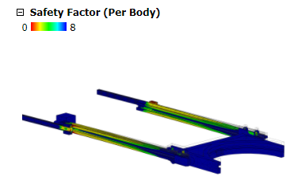

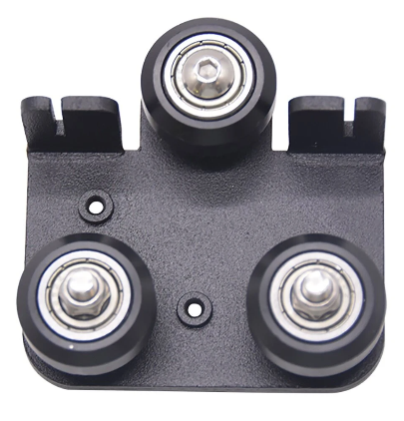
Evaluation and critical analysis
Battery life: 5 Hrs approx
Max tray load: 10 Kg
Weight: 100kg approx.

Slide 17
Safety features
Emergency stop button found on the top of the robot.
Weight limit breakable mechanism for tray mechanism (NEW).
Teleoperation/manual
Majority of surface material is aluminium, Easy to clean.
One tray off loaded at a time
Overloaded trays are left
Low centre of mass
Wheelbase breaking mechanism

Slide 18
Future improvements/alterations
Charging methods- Self charging dock, alternator
Heated/cooled cabinet
Tray breakable mechanism
Could we increase the number of trays while keeping a low profile?
Regenerative braking to extend operational span

Slide 19
References
[1] S. J. King and C. F. Weiman, "Helpmate autonomous mobile robot navigation system," in Mobile Robots V, 1991, vol. 1388: International Society for Optics and Photonics, pp. 190-198.
[2] C. A. A. Calderon, E. R. Mohan, and B. S. Ng, "Development of a hospital mobile platform for logistics tasks," Digital Communications and Networks, vol. 1, no. 2, pp. 102-111, 2015.
[3] J.-J. Bae and N. Kang, "Design optimization of a mecanum wheel to reduce vertical vibrations by the consideration of equivalent stiffness," Shock and Vibration, vol. 2016, 2016.
[4] INC., G., 2021. C Series Robots. [online] Geekplus.com. Available at: <https://www.geekplus.com/robot/c-robot> [Accessed 8 May 2021].
[5] Zhen An, L. H. (2016). Development of Mobile Robot SLAM Based on.

Slide 20
Thank you for listening! Questions...

